Slide 1


K.RAMAKRISHNAN COLLEGE OF ENGINEERING
(AUTONOMOUS)
BANK MANAGEMENT SYSTEM
Presented by,
Name : MURALI V
Register No. : 8115U24AM039
Roll No. : AM2439
Year : II /AI&ML
DATE OF REVIEW : 06/05/2026

Slide 2
PRESENTATION OVERVIEW
Objective
Introduction
Abstract
Architecture Diagram
Module Description
Implementation
Conclusion

Slide 3
OBJECTIVE
To develop a system for managing bank operations efficiently.
To store customer, account, and transaction details securely.
To reduce manual work and improve accuracy.
To provide quick access to banking data.
To ensure safe and reliable financial transactions.

Slide 4
INTRODUCTION
A Bank Management System is a database-based application that helps banks manage their daily operations such as customer details, account management, deposits, withdrawals, and transactions. This system replaces traditional manual record-keeping with an automated solution using DBMS, ensuring data consistency, security, and easy retrieval.

Slide 5
ABSTRACT
The Bank Management System is designed to handle banking activities in an efficient and organized manner. It uses a structured database to store information about customers, accounts, and transactions. The system allows users to perform operations like creating accounts, depositing money, withdrawing funds, and viewing account details. By using DBMS concepts such as tables, relationships, and queries, the system ensures data integrity and reduces redundancy. It provides a user-friendly interface and improves the overall banking experience.

Slide 6
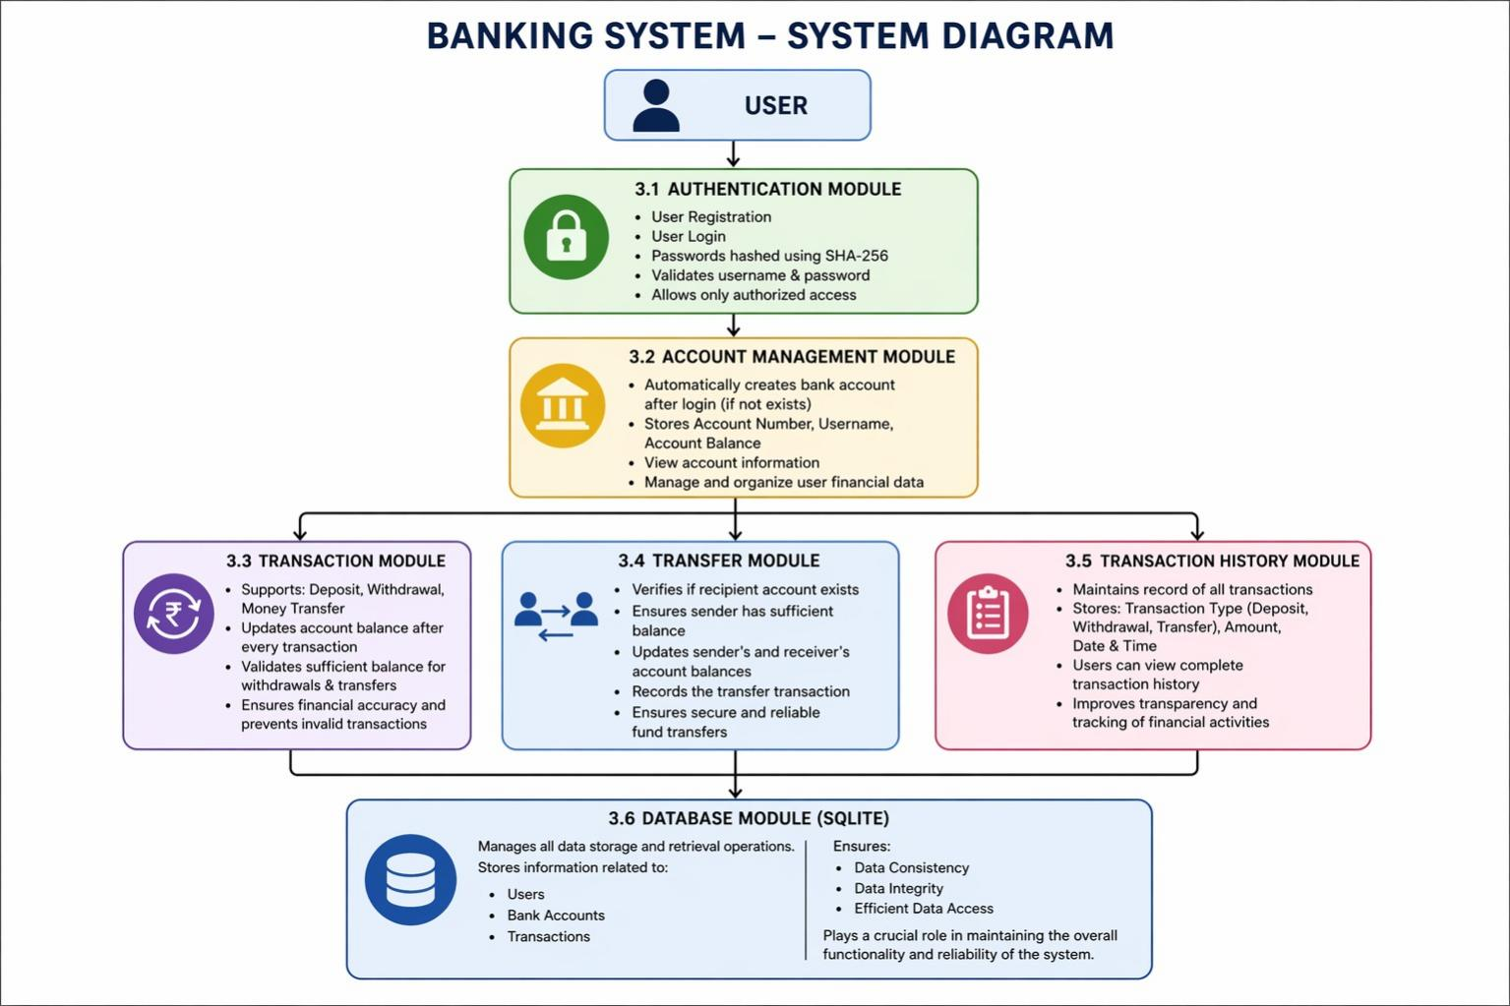
ARCHITECTURE DIAGRAM
.

Slide 7
MODULE DESCRIPTION
1. Authentication Module
Handles user login and logout functionality.
Verifies username and password using the database.
Ensures only authorized users can access the system.
Provides role-based access (User / Admin).
2. Account Management Module
Allows users to create new bank accounts.
Stores details like account number, type, and balance.
Supports updating and deleting account information.
Enables users to view account details.
.

Slide 8
MODULE DESCRIPTION
3. Transaction Module
Handles deposit and withdrawal operations.
Updates account balance after each transaction.
Ensures data consistency and accuracy.
Records each transaction in the database.
4. Transfer Module
Enables money transfer between accounts.
Verifies sender and receiver account details.
Checks sufficient balance before transfer.
Updates both accounts after successful transfer.
.

Slide 9
MODULE DESCRIPTION
5. Transaction History Module
Maintains a record of all transactions.
Allows users to view past transactions.
Supports filtering by date or transaction type.
Provides detailed transaction reports.
6. Admin Module
Gives full control to the administrator.
Manages users and accounts.
Monitors all transactions in the system.
Can block/unblock accounts if needed.
.

Slide 10
MODULE DESCRIPTION
7. Database Module
Manages storage of all data in the system.
Includes tables like Customer, Account, Transaction.
Maintains relationships between tables.
Ensures data integrity, security, and backup.
.

Slide 11
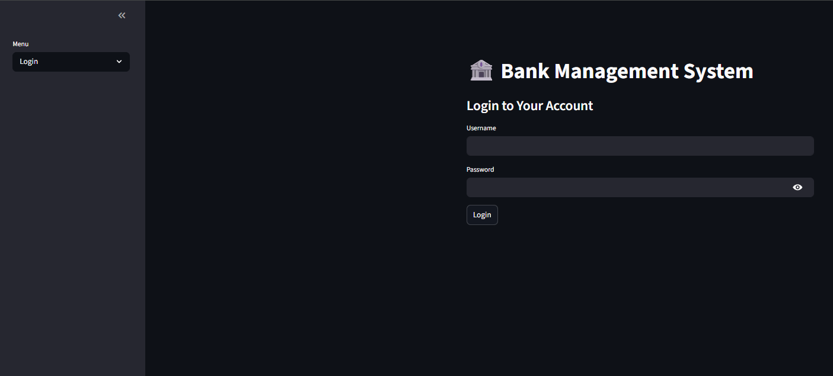
IMPLEMENTATION

Slide 12
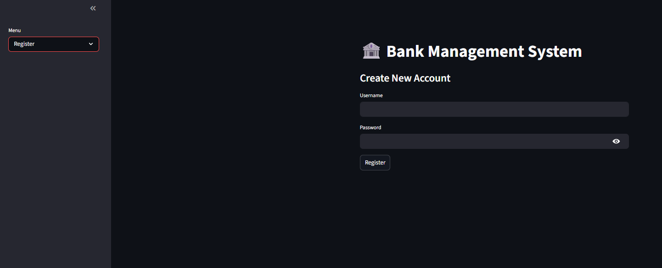
IMPLEMENTATION

Slide 13
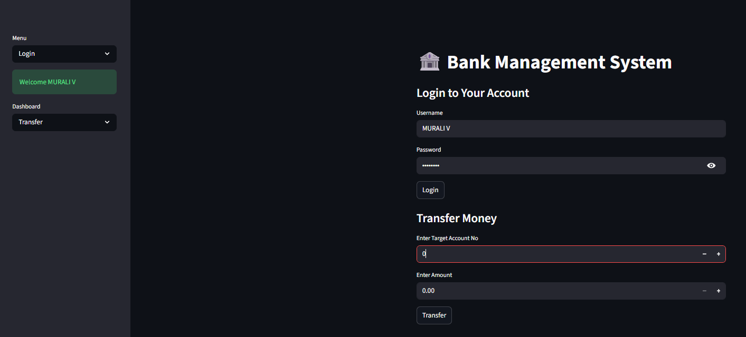
IMPLEMENTATION

Slide 14
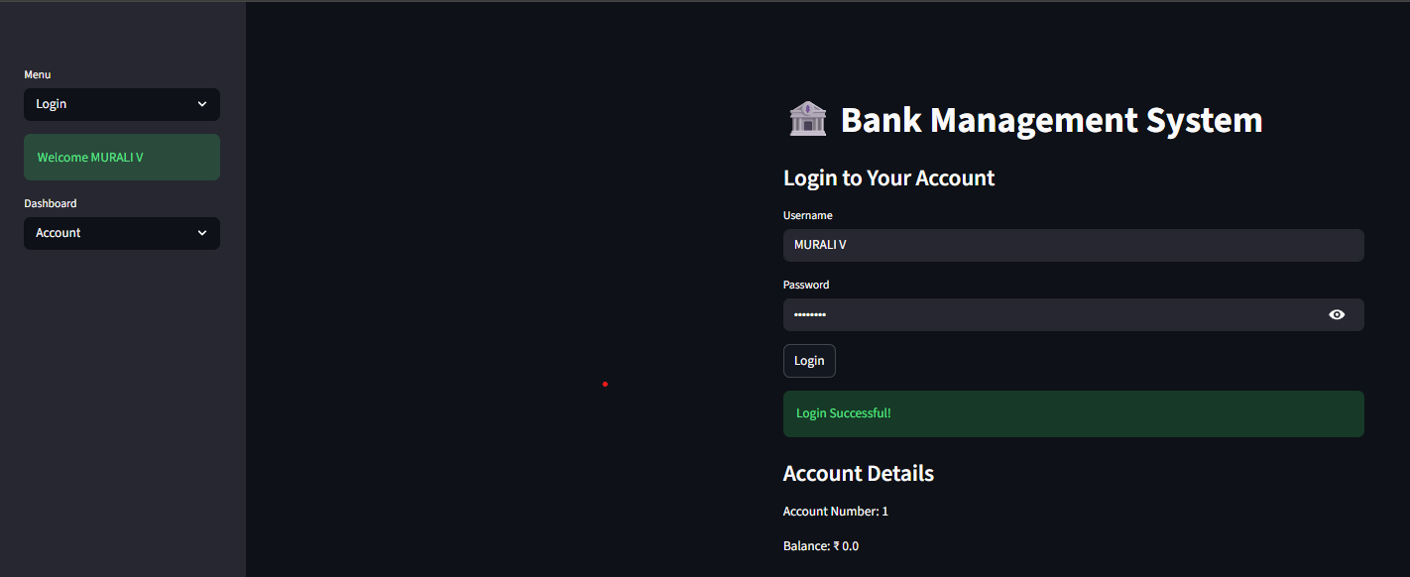
IMPLEMENTATION

Slide 15
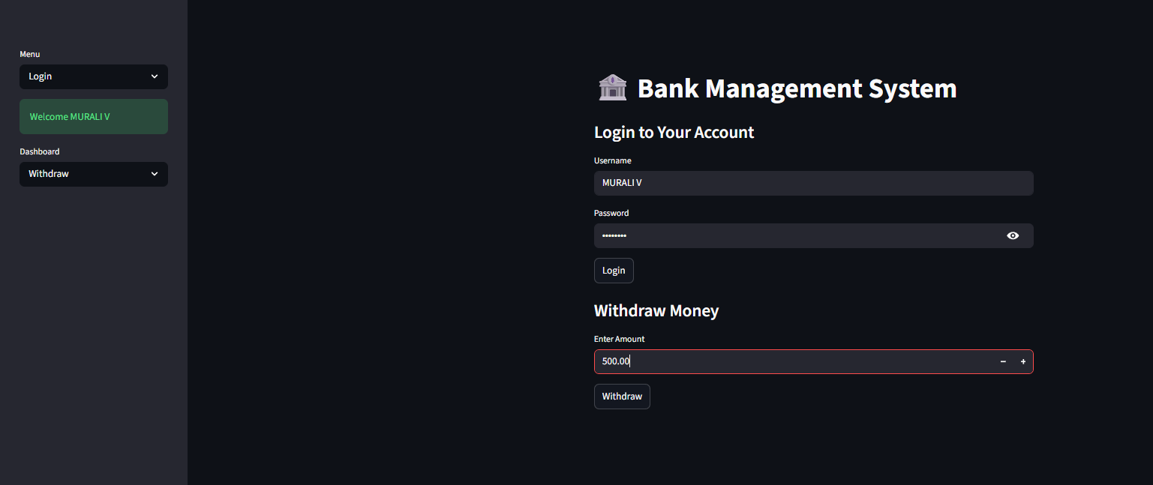
IMPLEMENTATION

Slide 16
CONCLUSION
The Bank Management System simplifies banking operations by automating data storage and processing. It improves efficiency, reduces errors, and ensures data security. This system demonstrates the effective use of DBMS concepts in real-world applications and can be further enhanced with advanced features like online banking and mobile access.

Slide 17


